Slide 1
The Real Von Trapp Family

Slide 2
The Real Von Trapp Family
Students will connect the musical, The Sound of Music, to a real, historical family through facts about the family and images.

Slide 3
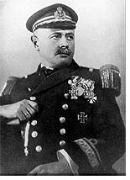
Georg Ritter von Trapp
Born on April 4th, 1880 in Zadar (now Croatia).
His father was a navy captain.
Met his first wife, Agathe Whitehead, at a ball in 1910.
Lady Whitehead died in 1922.

Slide 4
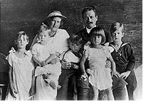
The Children
Agathe and the Captain had seven children:
Rupert, 1911
Agathe, 1913
Maria, 1914
Werner, 1915
Hedwig, 1917
Johanna, 1919
Martina, 1921
Then, Maria and the Captain had two more daughters of their own:
Rosemarie, 1928
Eleonore, 1931

Slide 5
Some of the children, when they came to the United States.

Slide 6
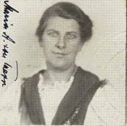
Maria
Maria came to the von Trapp family in 1926 as a tutor for one of the children, Maria, who was recovering from scarlet fever. She was not a governess to all the children.

Slide 7
The Real Von Trapp Family
There were nine total von Trapp children (children of both Agathe and Maria).
The names, ages, and genders of the children were changed in the film.
The family was musically inclined before Maria arrived, but she did teach them to sing madrigals.
A family friend, Father Franz Wasner, coached and conducted the family singing and encourage them to pursue singing as a profession.
Georg was not the detached, cold-blooded father who disapproved of music, as portrayed in the first half of The Sound of Music.
He was actually a gentle, warmhearted parent who enjoyed musical activities with his family.

Slide 8
Maria and Georg
After the first year of Maria working as a tutor, the children asked their father to do something to make her stay. They even suggested he should marry her. "I don’t even know if she likes me!“ was the captain’s answer. So, the children went to ask for themselves. When Maria said, "Yes, I do" they were engaged. She never returned to the abbey and married the Captain on November 26, 1927.
Maria and Georg were married 11 years before the family left Austria, not right before the Nazi takeover, as depicted in the musical.

Slide 9
The Real Von Trapp Family
The family lost most of its wealth through the worldwide depression when their bank failed in the early 1930’s.
Maria tightened belts all around by dismissing most of the servants and taking in boarders.
It was around this time that they began considering making the family hobby of singing into a profession. Georg was very protective of his family, so he was reluctant for the family to perform in public.
As depicted in The Sound of Music, the family won first place in the Salzburg Music Festival in 1936 and became successful, singing Renaissance and Baroque music, madrigals, and folk songs across Europe.

Slide 10
Their “Escape”
The family did not secretly escape over the Alps to freedom in Switzerland, carrying their suitcases and musical instruments.
Daughter Maria said, "We did tell people that we were going to America to sing. And we did not climb over mountains with all our heavy suitcases and instruments. We left by train, pretending nothing."
The von Trapps traveled to Italy, not Switzerland.
Georg was born in Zadar (now Croatia). Zadar became part of Italy in 1920, so Georg was thus an Italian citizen, and his wife and children as well.
The family had a contract with an American booking agent when they left Austria. They contacted the agent from Italy and requested fare to America.

Slide 11
Safely in America
In 1941, the Trapp family bought a large farm in Vermont, in a countryside very similar to the Austrian landscape near Salzburg that they missed.
The house they lived in was called "Cor Unum," which means "one heart."
On May 30th, 1947, Georg Ritter von Trapp passed away in Stowe, Vermont. He is buried in the family cemetery in a meadow behind the lodge.
On March 28th, 1987, Maria Augusta passed away in Stowe. She rests next to her husband in the family cemetery.

Slide 12
The Von Trapp Family Lodge in Vermont

Slide 13
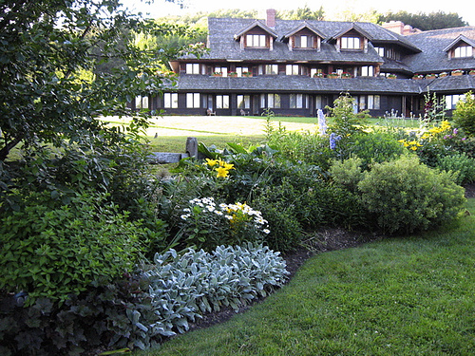
The Von Trapp Family Lodge in Vermont

Slide 14
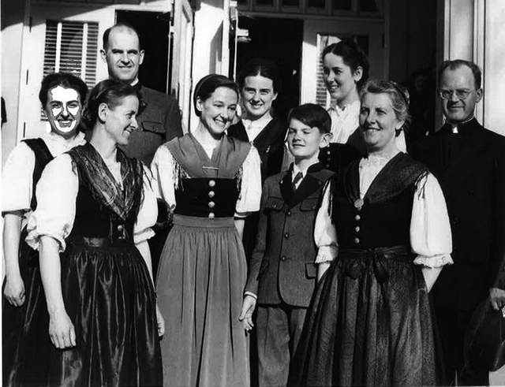
The Von Trapp Family

Slide 15
The Real Family Von Trapp
Students will connect the musical, The Sound of Music, to a real, historical family through facts about the family and images.

Slide 16
Sources and Further Reading
The Sound of Music Story, Tom Santopietro. New York: St. Martin’s Press, 2015
Forever Liesl: A Memoir of The Sound of Music, Charmain Carr and Jean A. S. Strauss. New York: Penguin Books, 2001.

